Slide 1
Designing great websites.
Sunny Patel

Slide 2
Little about me
Developing websites 6 years ago
Before frameworks and generators
Deeper understanding of the internal works
Worked for & led companies develop websites

Slide 3


Background
User interface – How a user can interact with a computer.
Mouse clicks, keyboard input
Buttons, text boxes & dropdowns.
User Experience – How a user feels about the entire process.

Slide 4
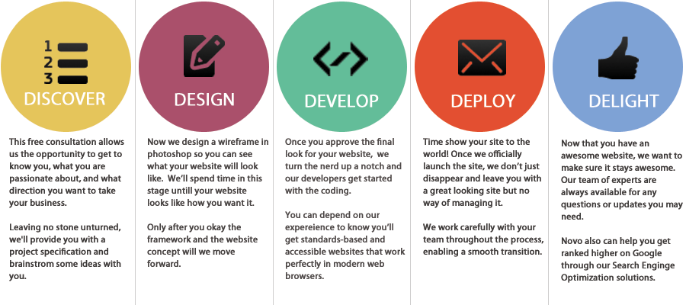
Overview
Learn about client
Passions
Goals
Focus
Wire framing
Black &White Sketches
Add color
Testing
Coding
Move to production
Security & User load checks
Maintenance
Updates
Collecting user data

Slide 5
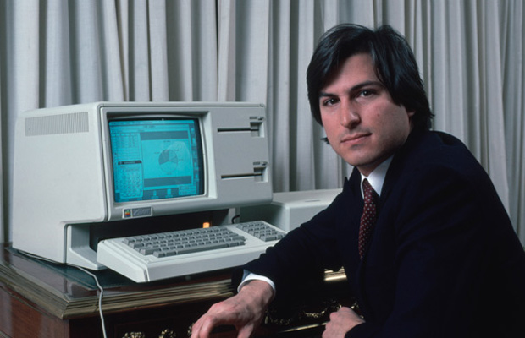
Design
"Design is a funny word. Some people think design means how it looks. But of course, if you dig deeper, it's really how it works." - Steve Jobs

Slide 6
Discovery
Learning about the client
What is important to them ?
What is their passion ?
What is the purpose ?
What problems are they facing?
Client
Everyone

Slide 7
Information Design
How to organize information
Information hiding
Best way to represent data
LAYOUT

Slide 8
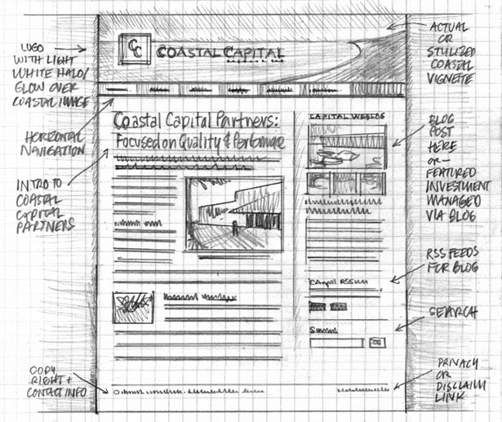
Wireframes
Show structure
Quick and easy editing
Black and White only
Functionally > Look & Feel
User interface

Slide 9
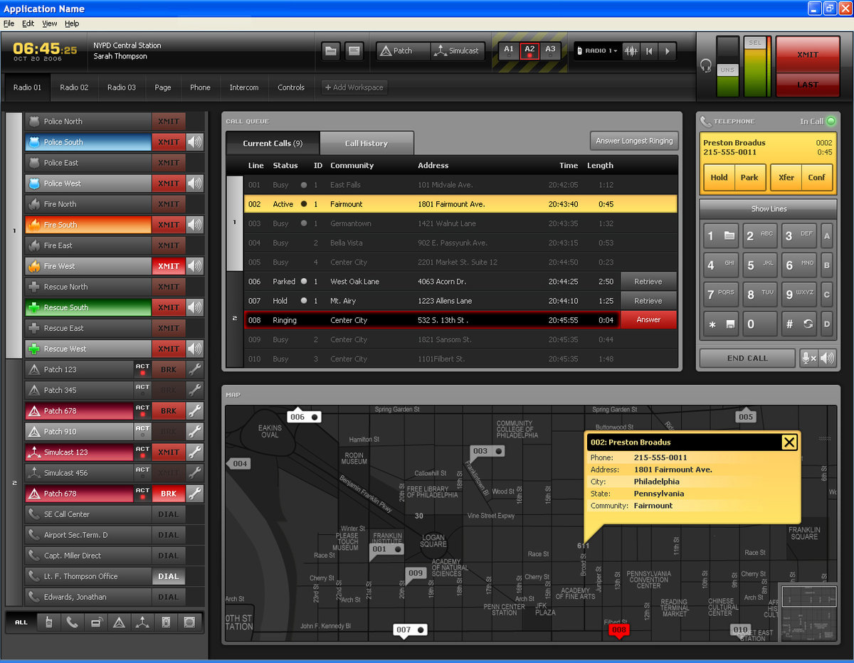
Color
Grab user’s attention only when needed
Can get tricky
Color can help:
Hide even more information
Highlight relevant information

Slide 10
Case studies & Recycle
No experience users do testing
Does it meet expectations ?
Auction : could the user find what he/she was looking for ?
Social : how long did the user spend on the site ?
Solve the problem?
Repeat…

Slide 11
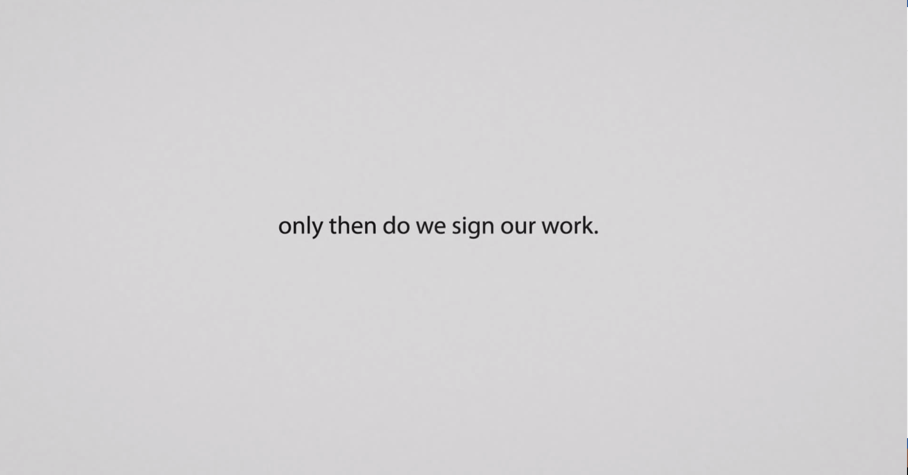

Slide 12
